Slide 1


KiKo the Robot
Moaz 175888

Slide 2
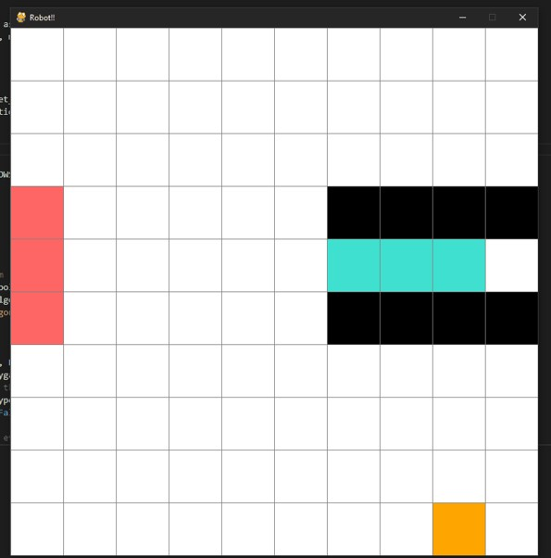
The original planner - BFS
Floods the gird in all directions without guidance.
Using the heuristic function to determine the closest box does not make a difference.

Slide 3

The original planner – A *
Allows the robot to go in the direction of the closest box.
Using the Heuristic function makes it choose the closest box/location as its goal and goes towards it.
Way faster than BFS

Slide 4
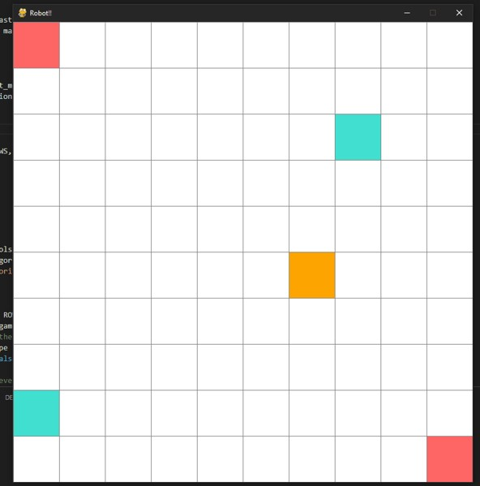
Heuristic Function
Finds the closest box/location to the robot at each step.

Slide 5
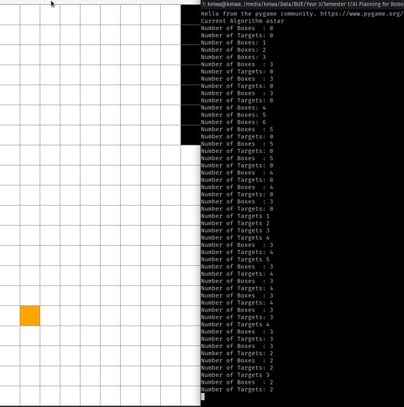
Generalization
Variable
grid size
Spots per row
Items locations
All items can be located anywhere in the grid

Slide 6
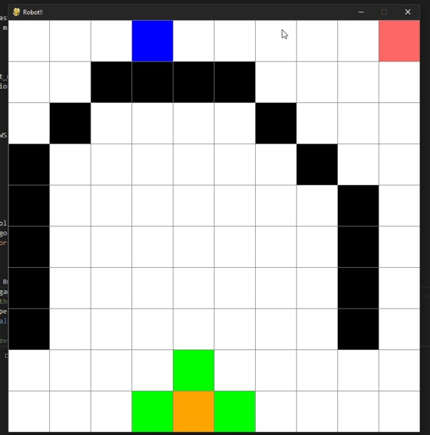
Not The Best Performance
The robot does not notice the barriers until it is too late.
Fixes can be
If we have a connected barrier, we can determine its start and end and check if there is any important items within, like a box or a target location, if not we can connect the start and end through a line of barriers.

Slide 7
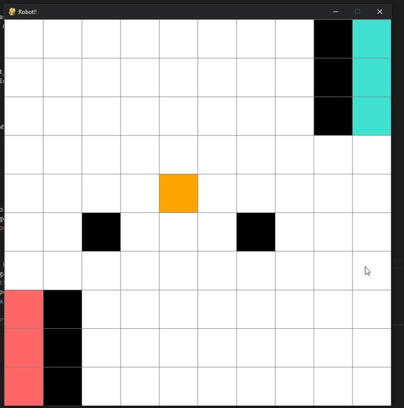
Failures
The robot puts the first box in the first location it finds and closes the path to the other target locations.
Suggested but not applied solutions
Using Reinforcement Learning the robot can learn from trail and erro and adapt automatically to this situation and similar ones.
We can make the robot locate all the target locations and all the boxes before changing any items
Before it changes any item, it can check if this will block access to other items or not
But this solution would require a lot of hardcoding and would take a lot of time to run.

